Slide 1
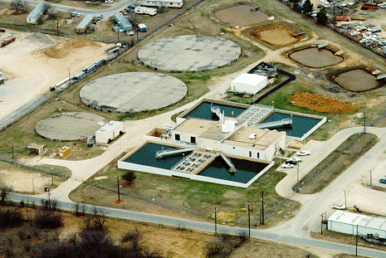
Sedimentation
   

Slide 2
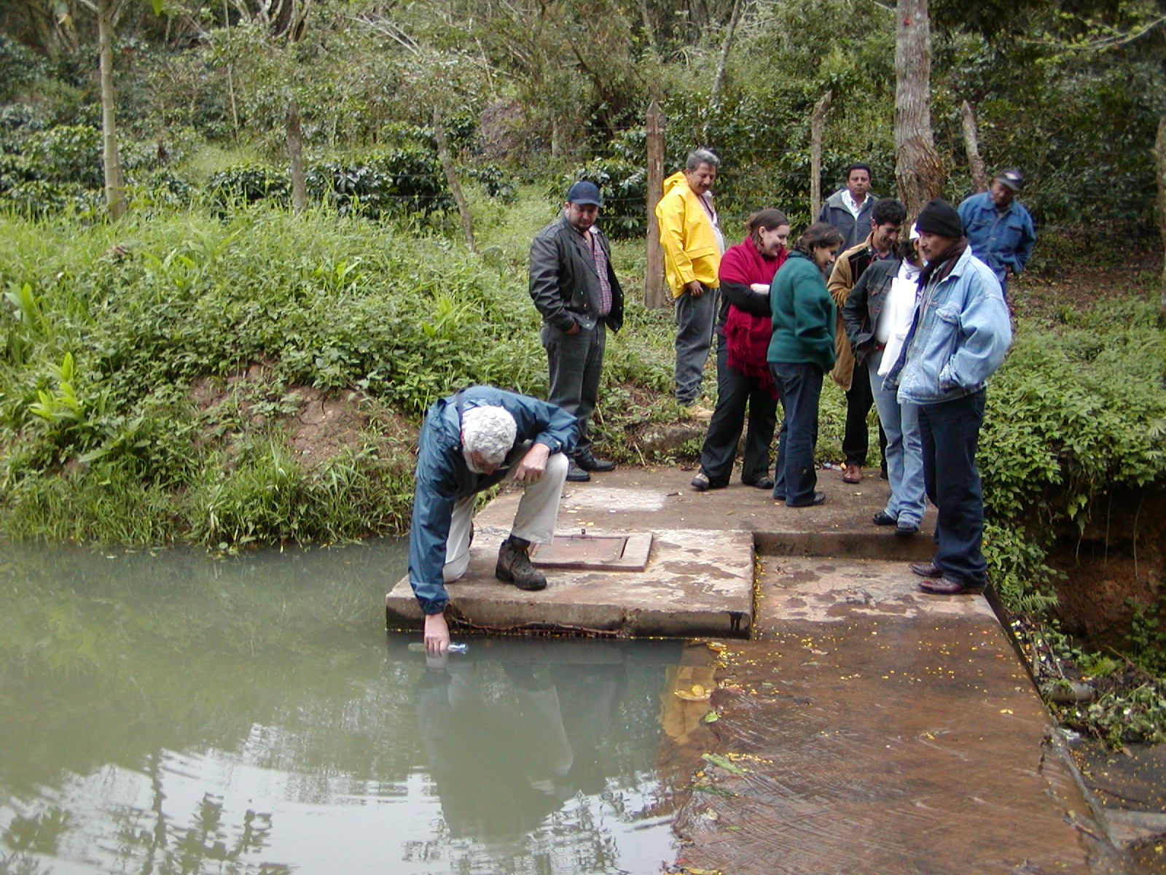
Simple Sorting
Goal: clean water
Source: (contaminated) surface water
Solution: separate contaminants from water
How?
Notes:
Identify a property of the contaminant that is different from that of pure water and exploit that difference to separate the contaminant from the water.

Slide 3
Where are we?
Unit processes* designed to
  remove _________________________
  remove __________ ___________
  inactivate ____________
*Unit process: a process that is used in similar ways in many different applications
Unit Processes Designed to Remove Particulate Matter
  Screening
  Coagulation/flocculation
  Sedimentation
  Filtration
Particles and pathogens
dissolved chemicals
pathogens
Empirical design
Theories developed later
Smaller particles

Slide 4
Conventional Surface Water Treatment
Raw water
Screening
Filtration
sludge
sludge
Alum
Polymers
Rapid Mix
Cl₂
Disinfection
Flocculation
Storage
Sedimentation
Distribution
sludge

Slide 5
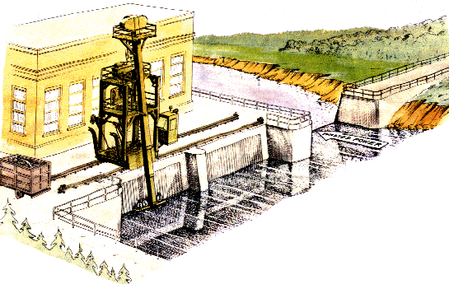
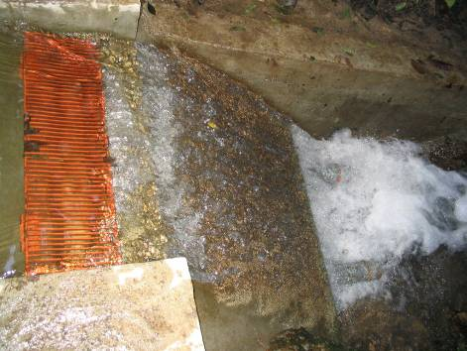
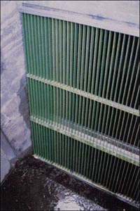
Screening
Removes large solids
  logs
  branches
  rags
  fish
Simple process
  may incorporate a mechanized trash removal system
Protects pumps and pipes in WTP

Slide 6
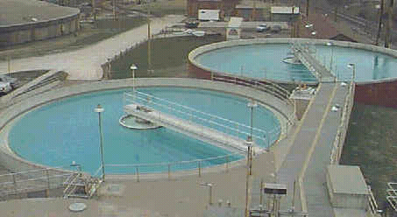
Sedimentation
the oldest form of water treatment
uses gravity to separate particles from water
often follows coagulation and flocculation

Slide 7
Sedimentation: Effect of the particle concentration
Dilute suspensions
  Particles act independently
Concentrated suspensions
  Particle-particle interactions are significant
  Particles may collide and stick together (form flocs)
  Particle flocs may settle more quickly
  At very high concentrations particle-particle forces may prevent further consolidation

Slide 8
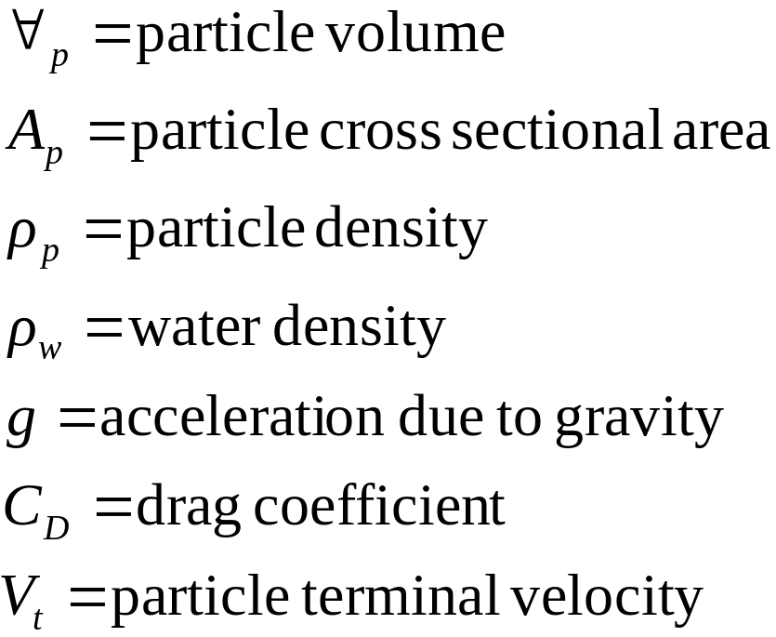








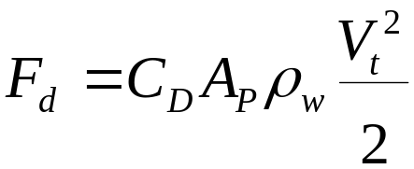

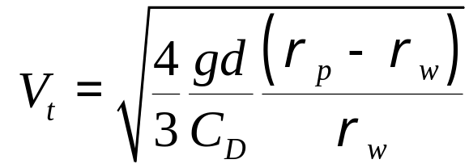
Sedimentation:
Particle Terminal Fall Velocity
Identify forces
projected

Slide 9
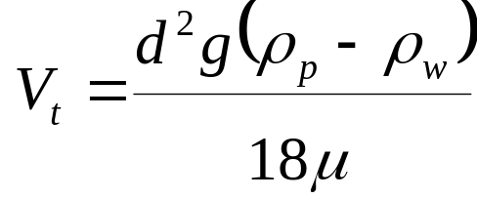
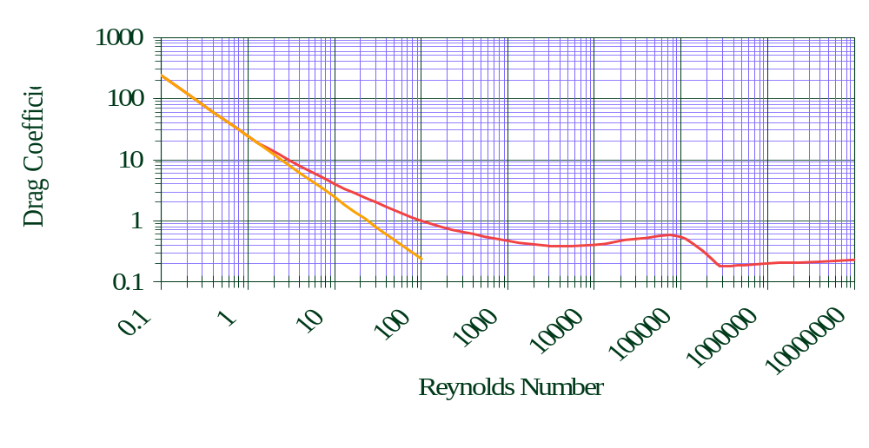
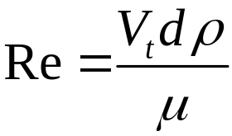
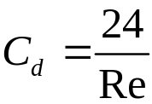
Drag Coefficient on a Sphere
Stokes Law
turbulent boundary
laminar
turbulent
Notes:
Tambo, N. and Y. Watanabe (1979). "Physical characteristics of flocs--I. The floc density function and aluminium floc." Water Research 13(5): 409-419.

Slide 10
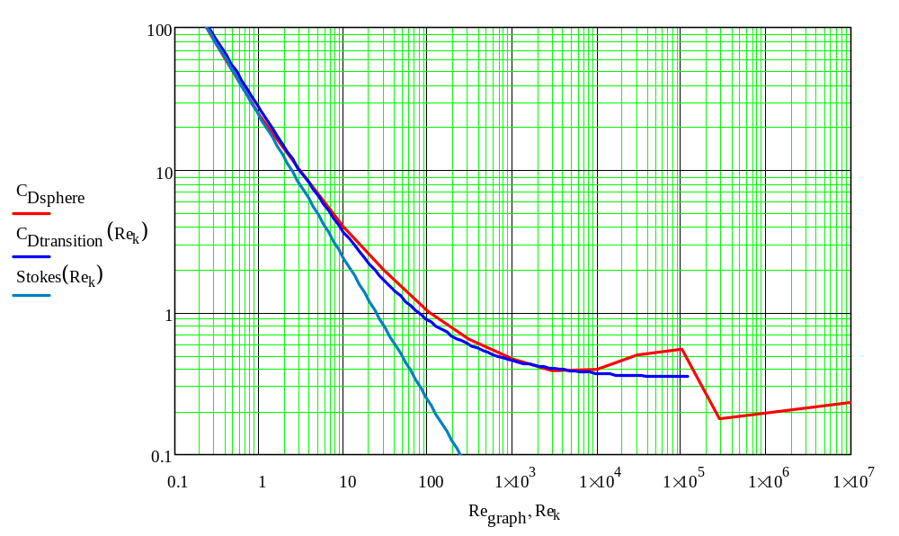
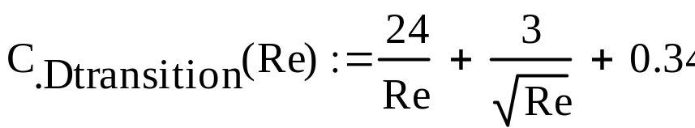
Floc Drag
Flocs created in the water treatment process can have Re exceeding 1 and thus their terminal velocity must be modeled using

Slide 11


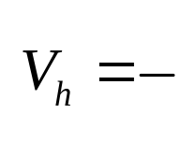



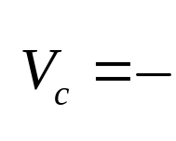
Sedimentation Basin:
Critical Path
Horizontal velocity
Outlet zone
flow rate
Inlet zone
H
WH
Sludge zone
Vertical velocity
L
Sludge out
V_{c} = particle velocity that just barely ______________
gets captured
What is V_{c} for this sedimentation tank?

Slide 12
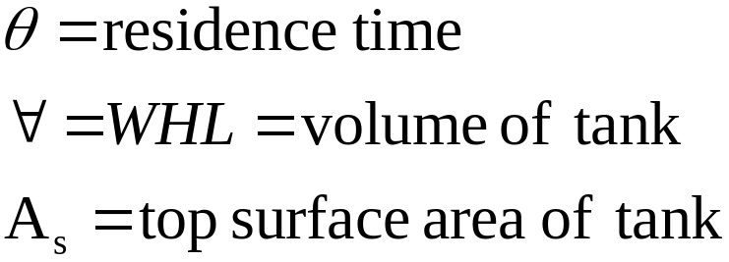
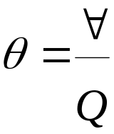
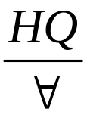

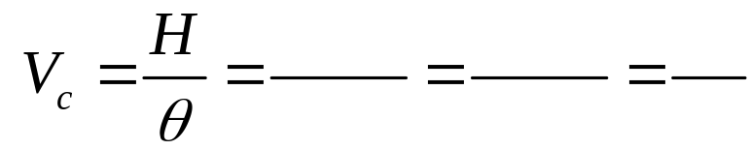
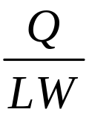


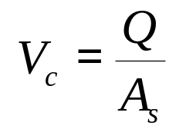
Sedimentation Basin:
Importance of Tank Surface Area
Time in tank
W
H
V_{c} is a property of the sedimentation tank!
L
Want a _____ V_{c}, ______ A_{s}, _______ H, _______ θ.
small
large
small
large
Suppose water were flowing up through a sedimentation tank. What would be the velocity of a particle that is just barely removed?

Slide 13
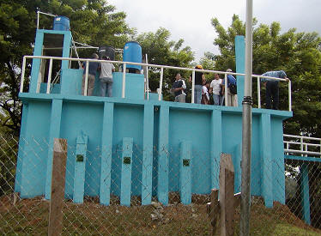
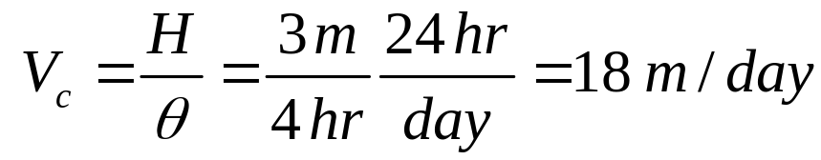
Conventional Sedimentation Basin
long rectangular basins
4-6 hour retention time
3-4 m deep
max of 12 m wide
max of 48 m long
What is V_{c} for conventional design?
Settling zone
Outlet zone
Inlet zone
Sludge zone
Sludge out

Slide 14
Design Criteria for Horizontal Flow Sedimentation Tanks
Settling zone
Outlet zone
Inlet zone
Sludge zone
_______________________________
_______________________________
_______________________________
_______________________________
_______________________________
V_{c} of 20 to 60 m/day*
Residence time of 1.5 to 3 hours*
Minimal turbulence (inlet baffles)
Uniform velocity (small dimensions normal to velocity)
No scour of settled particles
Slow moving particle collection system
Q/A_{s} must be small (to capture small particles)
* Schulz and Okun
And don’t break flocs at inlet!

Slide 15
Sedimentation Tank particle capture
What is the size of the smallest floc that can be reliably captured by a tank with critical velocity of 60 m/day?
We need a measure of real water treatment floc terminal velocities
Research…

Slide 16
Physical Characteristics of Floc: The Floc Density Function
Tambo, N. and Y. Watanabe (1979). "Physical characteristics of flocs--I. The floc density function and aluminum floc." Water Research 13(5): 409-419.
Measured floc density based on sedimentation velocity (Our real interest!)
Flocs were prepared from kaolin clay and alum at neutral pH
Floc diameters were measured by projected area
Notes:
Tambo, N. and Y. Watanabe (1979). "Physical characteristics of flocs--I. The floc density function and aluminium floc." Water Research 13(5): 409-419.
Check Water Quality and Treatment for additional relationships

Slide 17
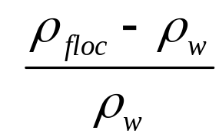
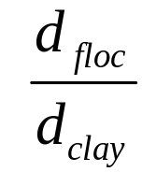
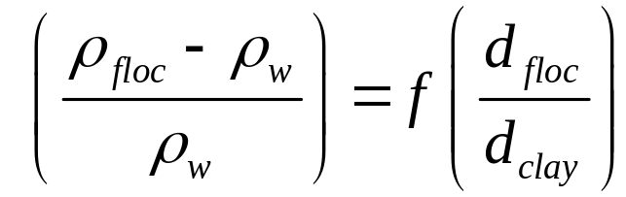
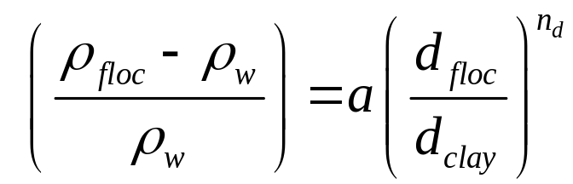
Floc Density Function:
Dimensional Analysis!
Floc density is a function of __________
Make the density dimensionless
Make the floc size dimensionless
Write the functional relationship
After looking at the data conclude that a power law relationship is appropriate
floc size
Notes:
Tambo, N. and Y. Watanabe (1979). "Physical characteristics of flocs--I. The floc density function and aluminium floc." Water Research 13(5): 409-419.

Slide 18
Model Results
For clay assume d_{clay} was 3.5 μm (based on Tambo and Watanabe)
a is 10 and n_{d} is -1.25 (obtained by fitting the dimensionless model to their data)
The coefficient of variation for predicted dimensionless density is
  0.2 for d_{floc}/d_{clay} of 30 and
  0.7 for d_{floc}/d_{clay} of 1500
The model is valid for __________flocs in the size range 0.1 mm to 3 mm
clay/alum
Notes:
Tambo, N. and Y. Watanabe (1979). "Physical characteristics of flocs--I. The floc density function and aluminium floc." Water Research 13(5): 409-419.

Slide 19
Additional Model Limitation
This model is simplistic and doesn’t include
  Density of clay
  Ratio of alum concentration to clay concentration
  Method of floc formation
Data doesn’t justify a more sophisticated model
Are big flocs formed from a few medium sized flocs or directly from many clay particles?
  Flocs that are formed from smaller flocs may tend to be less dense than flocs that are formed from accumulation of (alum coated) clay particles

Slide 20
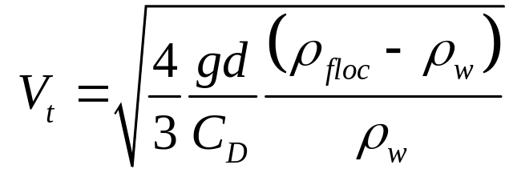
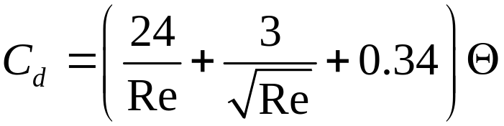
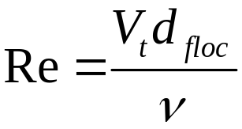
Model Results → Terminal Velocity
Θ = shape factor (1 for spheres)
Requires iterative solution for velocity
Notes:
Cd information from Tambo, N. and Y. Watanabe (1979). "Physical characteristics of flocs--I. The floc density function and aluminium floc." Water Research 13(5): 409-419.

Slide 21
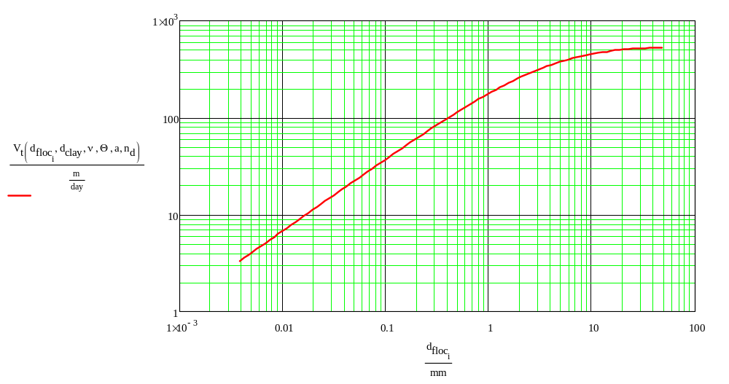
Floc Sedimentation Velocity
a: 10
n_{d}: -1.25
d_{clay}: 3.5 μm
Θ: 45/24

Slide 22
Floc density summary
Given a critical velocity for a sedimentation tank (V_{c}) we can estimate the smallest particles that we will be able to capture
This is turn connects back to flocculator design
We need flocculators that can reliably produce large flocs so the sedimentation tank can remove them

Slide 23
Flocculation/Sedimentation:
Deep vs. Shallow
Compare the expected performance of shallow and deep horizontal flow sedimentation tanks assuming they have the same critical velocity (same Q and same surface area)
deeper
More opportunities to ______ with other particles by _________ ____________ or ________________
Expect the _______ tank to perform better!
collide
differential
But the deep tank is expensive to make and hard to get uniform flow!
sedimentation
Brownian motion

Slide 24
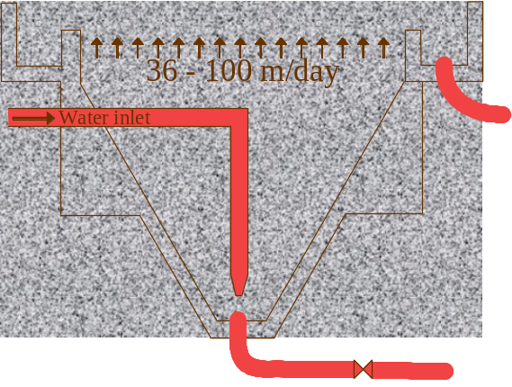
Flocculation/Sedimentation:
Batch vs. Upflow
Compare the expected performance of a batch (bucket) and an upflow clarifier assuming they have the same critical velocity
How could you improve the performance of the batch flocculation/sedimentation tank?

Slide 25
Lamella
Sedimentation tanks are commonly divided into layers of shallow tanks (lamella)
The flow rate can be increased while still obtaining excellent particle removal
Lamella decrease distance particle has to fall in order to be removed
Notes:
Lamella systems are essentially the same as conventional sedimentation tanks, except that a series of flat plates are fitted in the tanks, inclined at about 60o to the base of the tank. The plates are spaced at about 150 mm apart. Solid particles settle on to the surface of the plates and slide down the surface. The plates are scraped when excess sludge accumulates. Effective surface area for settlement is increased by the inclined plates giving such systems a smaller footprint than conventional tanks. Several variations on this theme are being developed by water companies, including tube settlement and mechanically rotating plates.
http://www.civl.port.ac.uk/enviro/EE%20INTRO%202004.doc
More lamella references
http://www.vateknik.lth.se/Education/UW/Solutions%202004/S18%20UW%202004.pdf
Journal paper
http://arjournals.annualreviews.org/doi/pdf/10.1146/annurev.fl.17.010185.000515;jsessionid=jxKgw91RCT3e

Slide 26
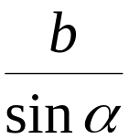

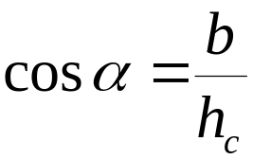
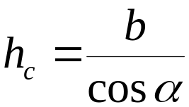


Defining critical velocity for plate and tube settlers
Path for critical particle?
How far must particle settle to reach lower plate?
h_{c}
L
h
b
α
What is total vertical distance that particle will travel?
α
V_{up}
V_{α}
What is net vertical velocity?

Slide 27
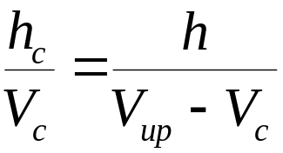
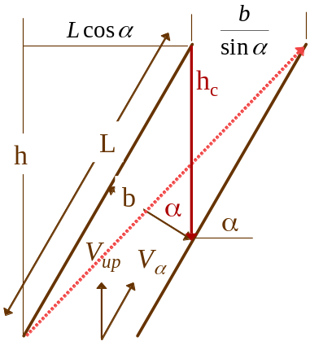
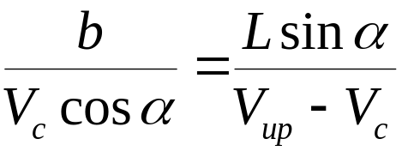


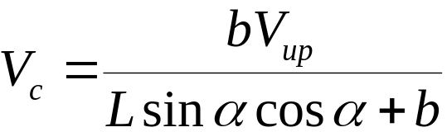
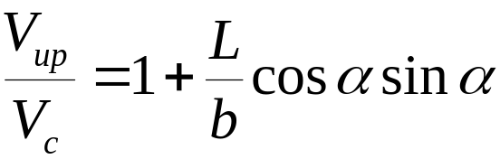
Compare times
Time to travel distance h_{c}
=
Time to travel distance h

Slide 28

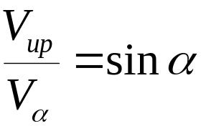
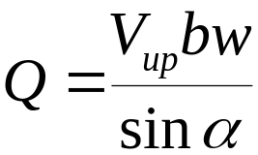
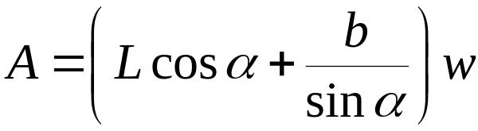
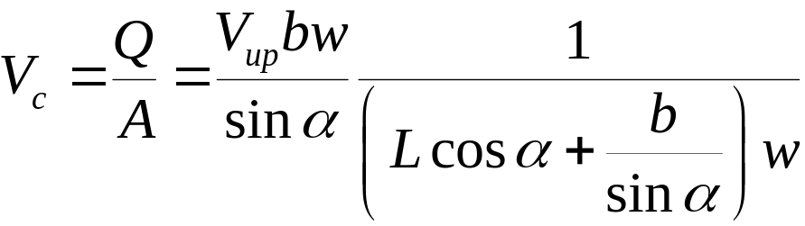
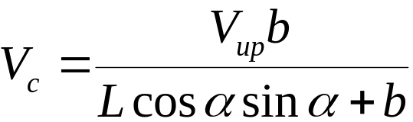
Comparison with Q/A_{s}
A_{s} is horizontal area over which particles can settle
h_{c}
L
h
b
α
α
V_{up}
V_{α}
Same answer!

Slide 29
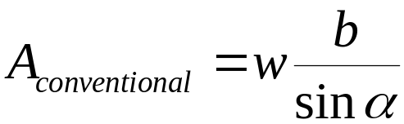
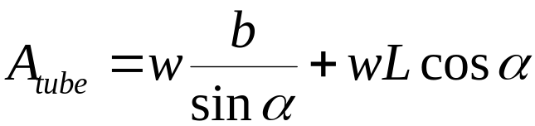
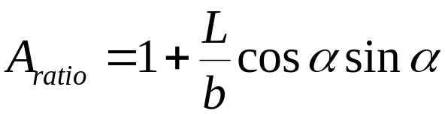

Performance ratio (conventional to plate/tube settlers)
Compare the area on which a particle can be removed
Use a single lamella to simplify the comparison
L
b
Conventional capture area
Plate/tube capture area
α

Slide 30


Critical Velocity Debate?
Schulz and Okun
Water Quality and Treatment (1999)
WQ&T shows this geometry
But has this equation
Weber-Shirk
Assume that the geometry is

Slide 31

Check the extremes!
90°
45°
10°
5°

Slide 32
Critical Velocity Guidelines
Based on tube settlers
  10 – 30 m/day
Based on Horizontal flow tanks
  20 to 60 m/day
Unclear why horizontal flow tanks have a higher rating than tube settlers
Could be slow adoption of tube settler potential
Could be upflow velocity that prevents particle sedimentation in the zone below the plate settlers
http://www.brentwoodprocess.com/tubesystems_main.html
Schulz and Okun

Slide 33

Problems with Big Tanks
To approximate plug flow and to avoid short circuiting through a tank the hydraulic radius should be much smaller than the length of the tank
Long pipes work well!
V_{c} performance of large scale sedimentation tanks is expected to be 3 times less than obtained in laboratory sedimentation tanks*
Plate and tube settlers should have much better flow characteristics than big open horizontal flow sedimentation tanks
Notes:
*Schulz and Okun page 140

Slide 34










Goal of laminar flow to avoid floc resuspension
Is Re a design constraint?
not a design constraint
Re is laminar for typical designs, _____________________

Slide 35

Mysterious Recommendations
Re must be less than 280 (Arboleda, 1983 as referenced in Schulz and Okun)
The entrance region should be discounted due to “possible turbulence” (Yao, 1973 as referenced in Schulz and Okun)
But this isn’t about turbulence (see next slide)!!!
At a Re of 280 we discard 36 and a typical L/b is 20 so this doesn’t make sense

Slide 36





Entrance Region Length
Distance for velocity profile to develop
laminar
turbulent

Slide 37
Entrance region
The distance required to produce a velocity profile that then remains unchanged
Laminar flow velocity profile is parabolic
Velocity profile begins as uniform flow
Tube and plate settlers are usually not long enough to get to the parabolic velocity profile
α

Slide 38


Lamella Design Strategy
Angle is approximately 60° to get solids to slide down the incline
Lamella spacing of 5 cm (b)
L varies between 0.6 and 1.2 m
V_{c} of 10-30 m/day
Find V_{up} through active area of tank
Find active area of sed tank
Add area of tank required for angled plates: add L*cos(α) to tank length

Slide 39

Sedimentation tank cross section
Effluent Launder (a manifold)

Slide 40
Design starting with Vup
The value of the vertical velocity is important in determining the effectiveness of sludge blankets and thus it may be advantageous to begin with a specified Vup and a specified Vc and then solve for L/b

Slide 41



Equations relating Velocities and geometry
Lamella gain
Continuity (Lengths are sed tank lengths)

Slide 42
Designing a plate settler
w_{plate}
b_{plate}
L_{plate}
Q_{plant}
N_{tanks}
α
Vertical space in the sedimentation tank divided between
  sludge storage and collection
  flow distribution
  Plates
  flow collection

Slide 43
AguaClara Plant Layout (draft)
Floc tank
Sed tanks
Chemical
store room
Effluent launders
Drain Valve access holes
Sed tank manifold
Steps
To the distribution tank

Slide 44
Distributing flow between tanks
Which sedimentation tank will have the highest flow rate?
Where is the greatest head loss in the flow through a sedimentation tank?
Either precisely balance the amount of head loss through each tank
Or add an identical flow restriction in each flow path
Where is the highest velocity?

Slide 45

Will the flow be the same?
Δh
Long
K=1
K=1
K=1
K=0.5
K=0.2
Short
K=1
Head loss for long route = head loss for short route if KE is ignored
Q for long route< Q for short route

Slide 46





Conservative estimate of effects of manifold velocity
Control surface 1_{l}
long
short
cs 2
cs 3
cs 4
cs 5
Long orifice
Short orifice

Slide 47




Modeling the flow
This neglects velocity head differences
Since each point can have only one pressure
We are assuming that minor losses dominate. It would be easy to add a major loss term (fL/d). The dependence of the friction factor on Q would require iteration.
Notes:
This analysis isn’t right because the head loss isn’t the same for the two paths. But it is approximately correct because as part of the design process we make sure that the head loss through the ports is almost the same.

Slide 48



Design a robust system that gets the same flow through both pipes
Add an identical minor head loss to both paths
Solve for the control loss coefficient
Design the orifice…

Slide 49





Piezometric head decrease in a manifold assuming equal port flows
Head loss
Kinetic energy
Piezometric head decrease in a manifold with n ports
d is the manifold diameter
represents the head loss coefficient in the manifold at each port or along the manifold as fL/d
Note that we aren’t using the total flow in the manifold, we are using Q_{port}

Slide 50




Convert from port to total manifold flow and pressure coefficient
Loss coefficient
Velocity head
Note approximation with f
These are losses in the manifold

Slide 51



Calculate additional head loss required to get uniform flow
Long path
Short path
Note that this K_{long} gives the correct head loss when using Q_{maxmanifold}
K_{control} is the minor loss coefficient we need somewhere in the ports connecting to the manifold

Slide 52




Total Loss Coefficient
We are calculating the total loss coefficient so we can get a relationship between the total available piezometric head and the diameter of the manifold
Including KE (more conservative)
Excluding KE
Notes:
Not sure which equation should be used

Slide 53



Calculate the manifold diameter given a total manifold head loss
K_{total} is defined based on the total flow through the manifold and includes KE .
Minor loss equation
Solve the minor loss equation for D
We could use a total head loss of perhaps 5 to 20 cm to determine the diameter of the manifold. After selecting a manifold diameter (a real pipe size) find the required control head loss and the orifice size.

Slide 54


Full Equation for Manifold Diameter
∑ C_{p} is loss coefficient for entire length of manifold

Slide 55

Manifold design equation with major losses
Iteration is required!
n is number of ports
f is friction factor (okay to use f based on Q_{total})
Q_{ratio} is acceptable ratio of min port flow over max port flow
h_{l} is total head loss through the ports and through the manifold
Q_{manifold} is the total flow through the manifold from the n ports
∑K is the sum of the minor loss coefficients for the manifold (zero for a straight pipe)

Slide 56


Head loss in a Manifold
The head loss in a manifold pipe can be obtained by calculating the head loss with the maximum Q through the pipe and then multiplying by a factor that is dependent on the number of ports.

Slide 57


Now find the effluent launder orifice area
Use the orifice equation to figure out what the area of the flow must be to get the required control head loss. This will be the total area of the orifices into the effluent launder for one tank.

Slide 58




Orifice flow (correction!)
Solve for h and substitute area of a circle to obtain same form as minor loss equation
K_{or} = 0.63
2.5 d
8 d
Δh
D
d

Slide 59


Calculating the orifice diameter based on uniform flow between orifices

Slide 60


How small must the orifice be?
Case of 1 orifice
For this case d_{orifice} must be approximately 0.56d_{pipe}.
We learned that we can obtain equal similar parallel flow by ensuring that the head loss is similar all paths.
We can compensate for small differences in the paths by adding head loss that is large compared with the small differences.

Slide 61
Effluent Launders:
Manifold Manifolds
Two Goals
  Extract water uniformly from the top of the sed tank so the flow between all of the plates is the same
  Create head loss that is much greater than any of the potential differences in head loss through the sedimentation tanks to guarantee that the flow through the sedimentation tanks is distributed equally
A pipe with orifices
Recommended orifice velocity is 0.46 to 0.76 m/s (Water Treatment Plant Design 4th edition page 7.28)
  The corresponding head loss is 3 to 8 cm through the orifices
  but it isn’t necessarily this simple!
We need to get a low enough head loss in the rest of the system
Notes:
Water Treatment Plant Design 4th edition page 7.28

Slide 62
Effluent Launders and Manifold
We need to determine
  the required diameter of the effluent launder pipe
  The number and the size of the orifices that control the flow of water into the effluent launder
  The diameter of the manifold
The head loss through the orifices will be designed to be large relative to the differences in head loss for the various paths through the plant
We need an estimate of the head loss through the plant by the different paths
Eventually take into account what happens when one sedimentation tank is taken off line.

Slide 63
Head Loss in a sed tank?
Head loss through sed tank inlet pipes and plate settlers is miniscule
The major difference in head loss between sed tanks is due to the different path lengths in the manifold that collects the water from the sed tanks.
We want equally divided flow two places
  Sed tanks
  Plate settlers (orifices into launders)

Slide 64
Manifold head loss:
Sed tanks equal!
We will assume minor losses dominate to develop the equations. If major losses are important they can be added or modeled as a minor loss.
The head loss coefficient from flowing straight through a PVC Tee is approximately 0.2
We make the assumption that the flow into each port is the same
Eventually we will figure out the design criteria to get identical port flow

Slide 65





Minor losses vs. Major losses
Compare by taking a ratio
Thus in a 10 cm diameter pipe, an elbow with a K of 1 gives as much head loss as 5 m of pipe

Slide 66
Now design the Effluent Launder
The effluent launder might be a smaller diameter pipe than the sed tank manifold (especially if there are many sedimentation tanks)
The orifice ports will be distributed along both sides of the launder

Slide 67
Now design the Effluent Launder
Port spacing should be less than the vertical distance between the ports and the top of the plate settlers (I’m not sure about this constraint, but this should help minimize the chance that the port will cause a local high flow through the plate settlers closest to the port)
The depth of water above the plate settlers should be
  0.6 to 1 m with launders spaced at 1.5 m (Water Treatment Plant Design 4th edition page 7.24)
  This design guideline forces us to use a very deep tank. Deep tanks are expensive and so we need to figure out what the real constraint is.
  It is possible that the constraint is the ratio of water depth to launder spacing.

Slide 68
Effluent Launder
The solution technique is similar to the manifold design
We know the control head loss – the head loss through the ports will ensure that the flow through each port is almost the same
We need to find the difference in the head loss between the extreme paths
Then solve for the diameter of the effluent launder

Slide 69
Sedimentation Tank Appurtenances
Distributing the flow between parallel tanks
Effluent Launders
Sludge removal (manifold design similar to effluent launders)
Isolating a tank for fill and drain: using only a single drain valve per tank
  Filling the tank with clean water
  Not disturbing the water levels in the rest of the plant
Entrance manifolds: designed to not break up flocs

Slide 70
launder
Sludge drain line that discharges into a floor drain on the platform
Plate settlers
Sludge
drain

